Slide 1
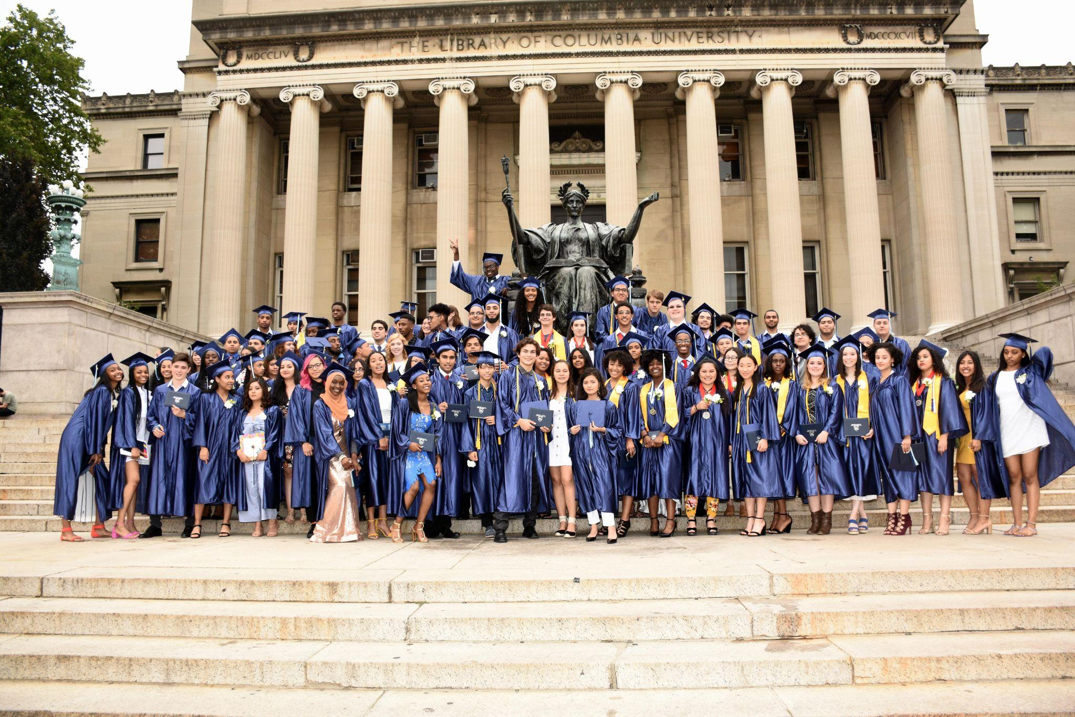
Friends of CSS
A PRIMER

Slide 2
Friends of CSS
Who are Friends of CSS?
How does FoCSS receive funds?
How does FoCSS spend funds?
How can I get involved?

Slide 3
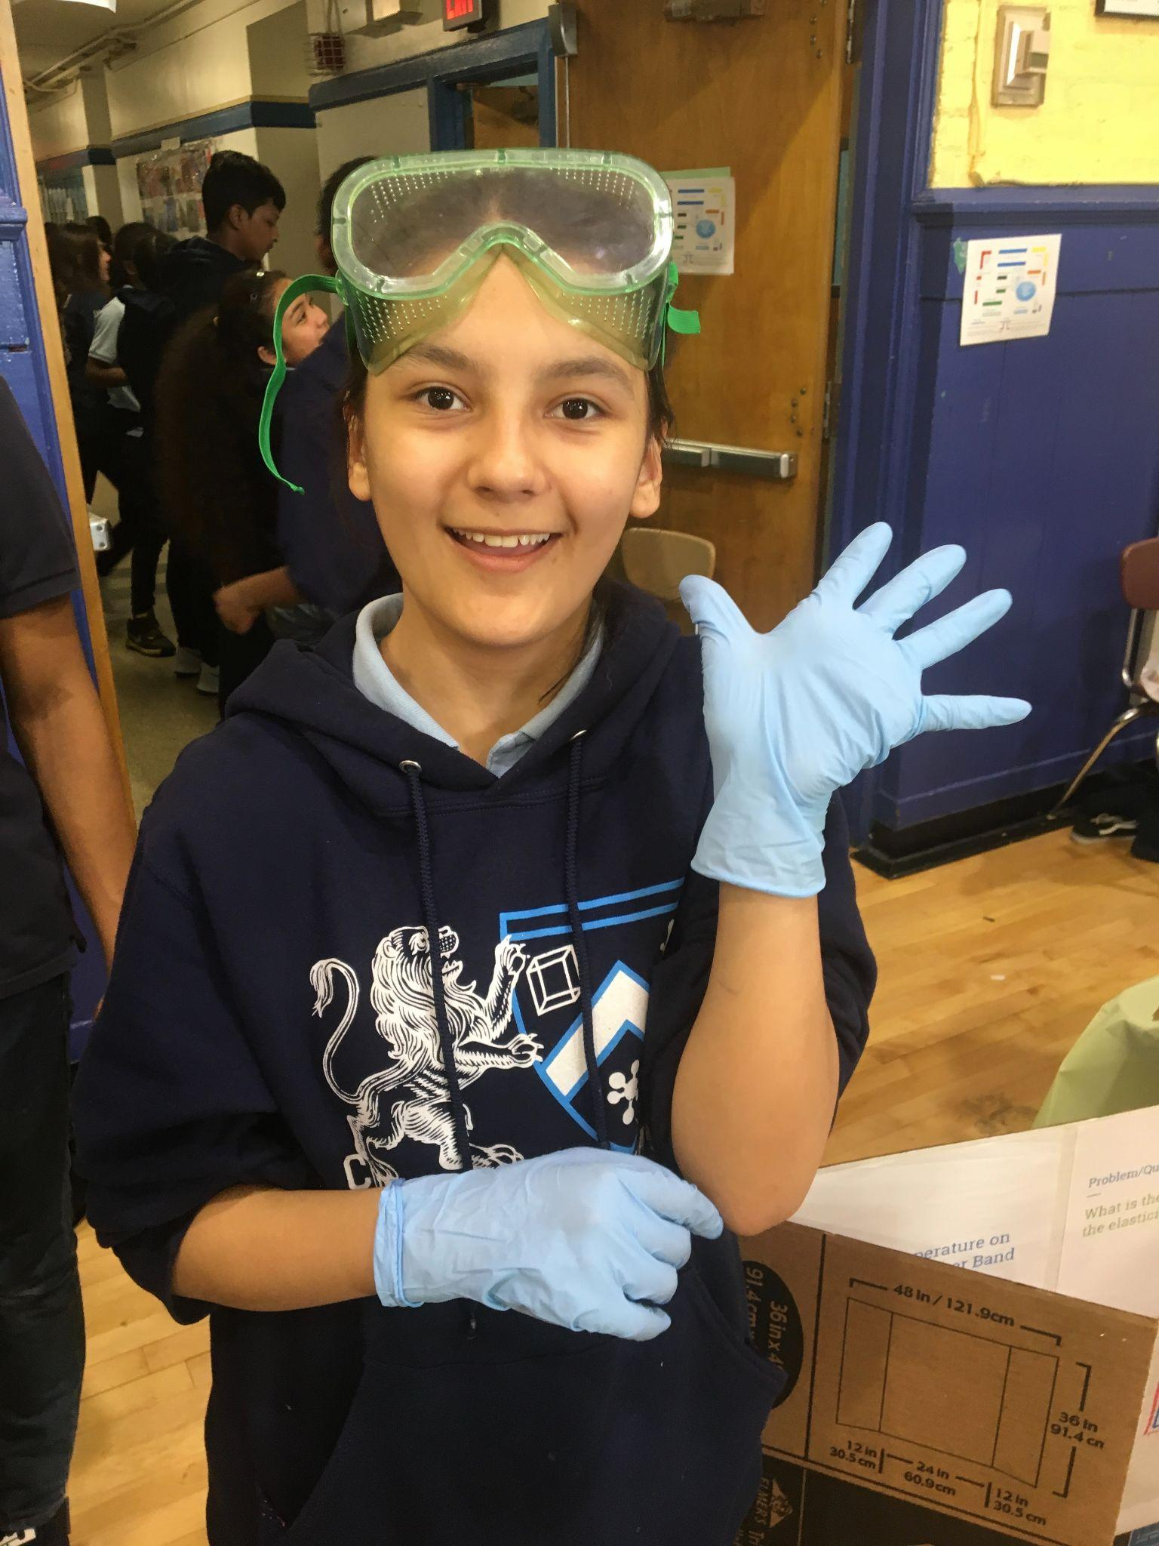
Who are Friends of CSS?

Slide 4
FoCSS Mission
The purpose of FoCSS is to enhance the educational experiences of the students, teachers and staff of Columbia Secondary School for Math, Science, and Engineering, a New York City public school in upper Manhattan that serves a diverse population of academically talented students.

Slide 5
Who are Friends of CSS?
Friends of CSS is a non-profit (501c3) made up of current and former parents, students and staff who serve on a volunteer basis and meet monthly. Current members are:
Min Hong
Leanne Gonzalez-Singer
Mark Kerman
Solenn de Kersauson
David LurveDave Thom
Kit McArthur
FoCSS is a listed 501c3 on GuideStar and Cause IQ, which are websites where 501c3 organizations are registered. We are audited and file financial reports with the IRS.
Marie McArthur
Miriam Nightengale
Nathanial Polish
Nydia Prishker
Kian Tajbakhsh
Dave Thom
The PTA President also sits on the FoCSS Board,
The Principal sits on the FoCSS Board

Slide 6
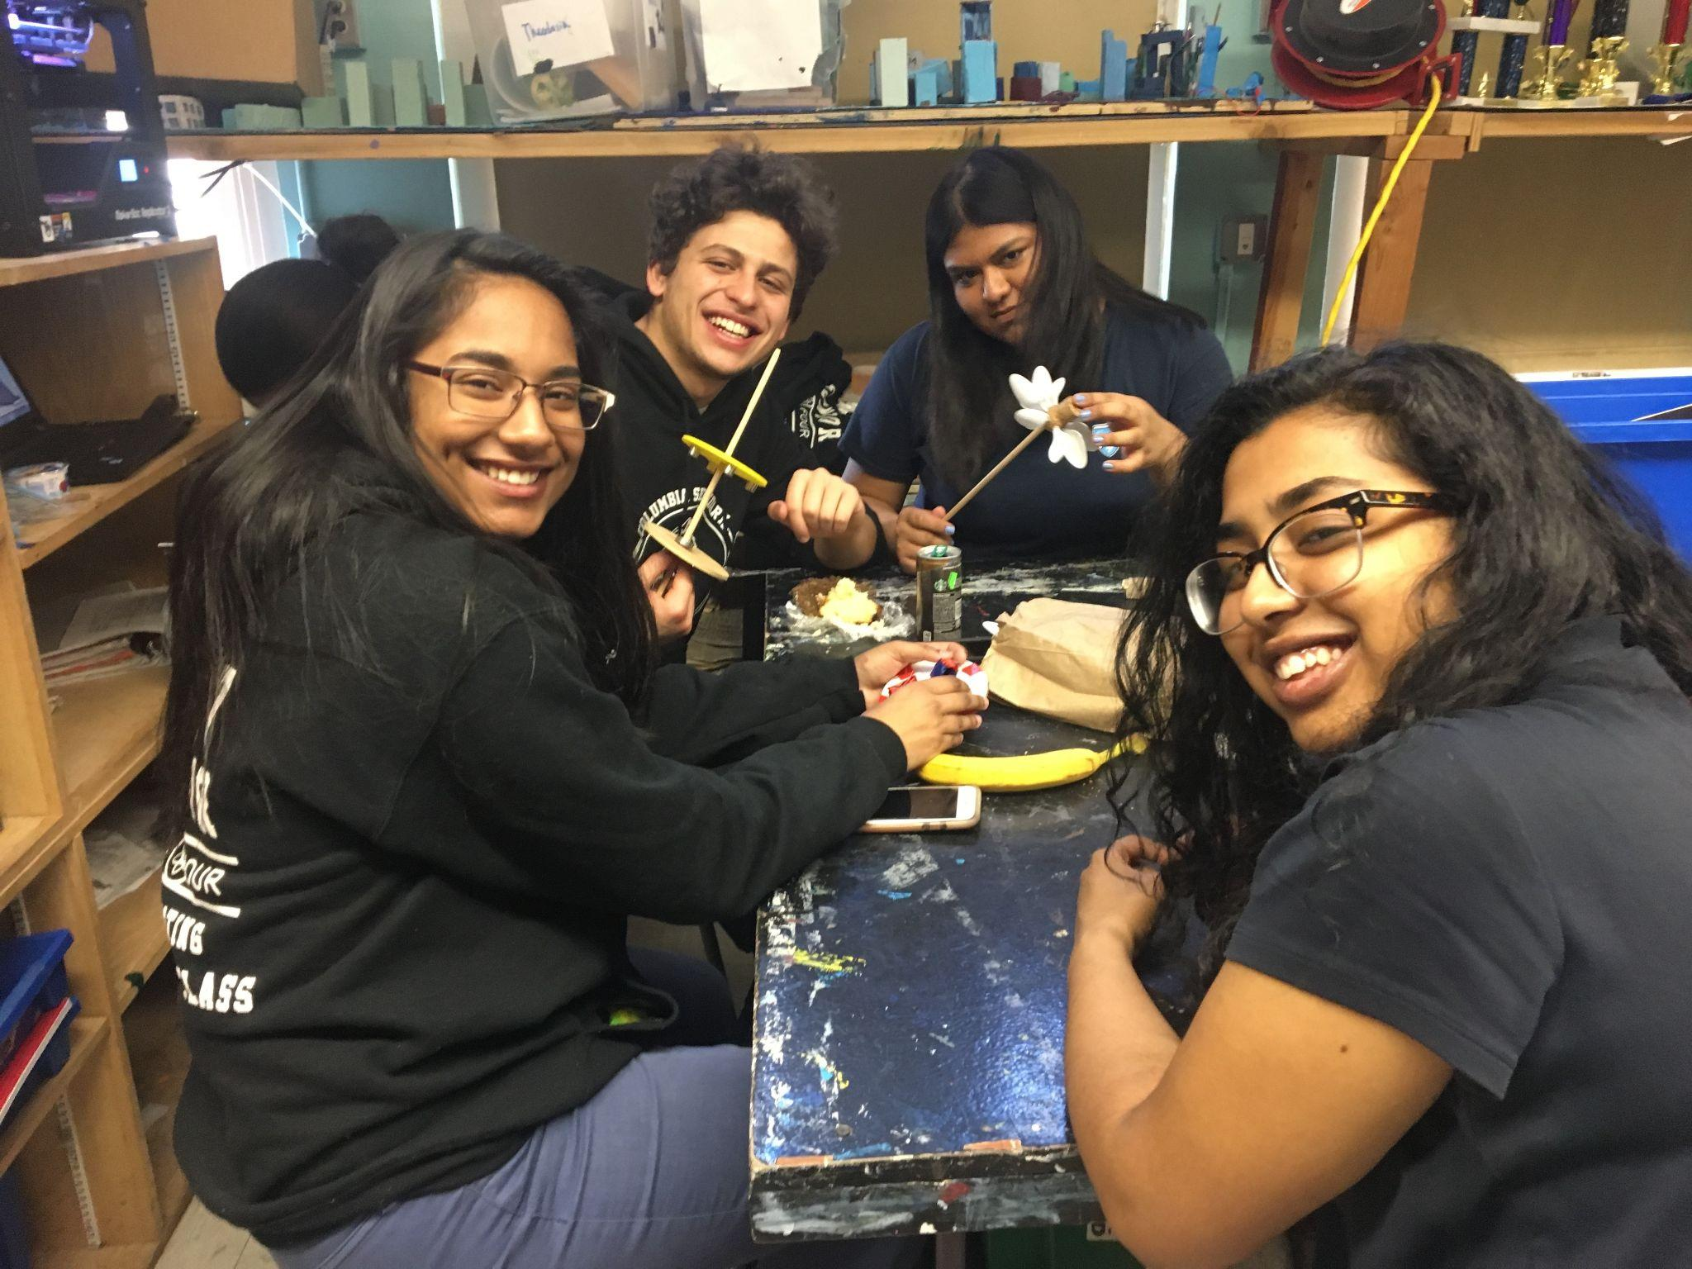
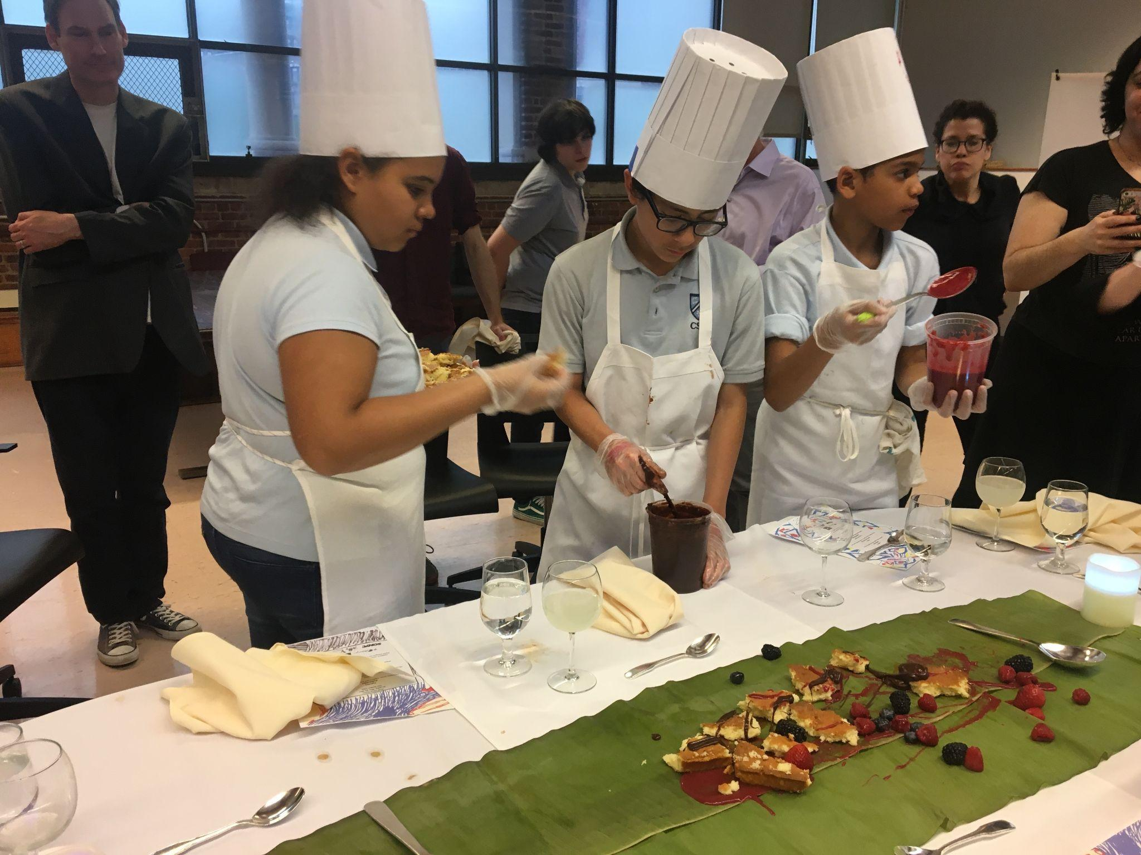
Who are Friends of CSS?
FoCSS is a group of current and former community members
who work together to provide the personnel, activities and programs that set CSS apart from other schools!

Slide 7
Who are Friends of CSS?
Friends of Columbia Secondary School for Math, Science, Engineering, Inc., is a New York state charitable corporation that was formed to support the academic mission of CSS. All contributions to Friends of CSS are deductible from federal and state income taxes to the full extent allowed by law.
FoCSS is separate and independent from both the PTA and from the DOE, although the Friends and PTA regularly consult to coordinate efforts where appropriate.

Slide 8
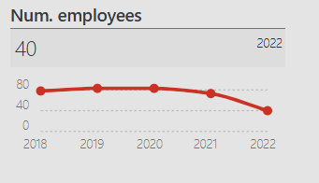
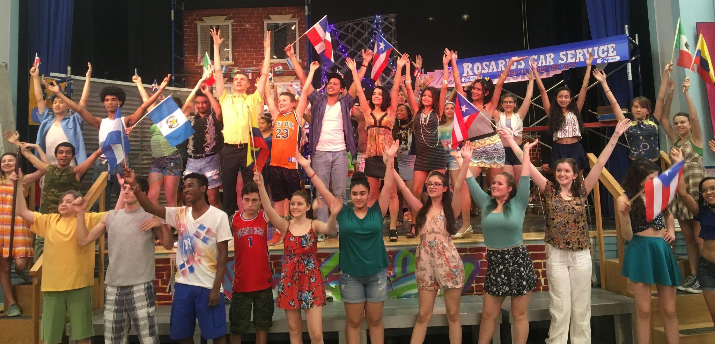
Did you know that FoCSS is the main employer at CSS, after the school itself?
We fund multiple salaried positions, as well as provide supplemental funds for staff who engage students in after-school activities, from the musical to sports to field trips to robotics!
Our funding pays CSS staff to provide the extra-curricular activities that make CSS special!
Source: CauseIQ
Oct 2023

Slide 9
Who are Friends of CSS?
Friends of Columbia Secondary School for Math Science and Engineering enhances the educational experience of students, teachers, and staff at a New York City public 6th through 12th-grade school. They support popular after-school elective programs and purchase engineering and technology equipment. Their approved programs include experiential learning field trips and other activities.
Also known as...
Foundation for Excellence in Education
Program areas at Friends of Columbia Secondary School for Math Science and Engineering
After School - experiential learning field trips and other activities.
Academic - popular after School elective programs and purchase of Engineering and technology equipment.
College counseling - college guidance and advice.
Friends of Columbia Secondary School for Math Science and Engineering
IRS 501(c) type: 501(c)(3)
Num. employees: 40
City: New York State:New York
Year formed: 2008
Most recent tax filings:2022-06-01
This is the most recent report published on CauseIQ. This information is updated annually and you can find it online at the 501c3 clearing houses like GuideStar and CauseIQ.

Slide 10
Where do FoCSS funds come from?

Slide 11
Where do FoCSS funds come from?
Columbia University provides $100,000 - $150,000 per year.
An endowment of $5,000,000 set up by a donor in 2011 has provided support and salaries for our college office and supplemented the cost of college trips over the years. This endowment is managed by Columbia University.
You! Parents and community members are important sources of funding for FoCSS. Our community has helped support FoCSS-funded activities by:
Direct contribution. You can donate through our PayPal account or through check or even cash!
Matching grants: Many employers provide matching funds which can double the impact of your contribution. Check with your employer!
Identifying grants, foundations and donors which/who may be able to support CSS’s unique academic and extra-curricular activities through monetary donations or grants.

Slide 12
Where do FoCSS funds come from 2022 detail
Grantmaker | Grantmaker tax period | Description | Amount
Columbia University | 2022-06 | Program Services | $300,000
West Harlem Development Corporation | 2021-12 | To Train Students To Be Socially and Politically Conscious, To Be Aware of Their Responsibility To Their Communities and the World, and To Be Dedicated To A Life of Creation and Discovery in Service of Humanity. | $7,500
W P Carey Foundation (WPCF) | 2021-12 | Charitable | $1,000

Slide 13
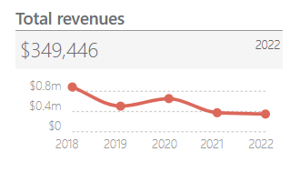
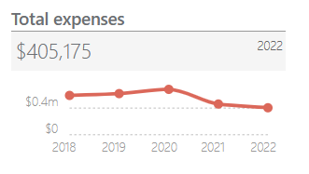
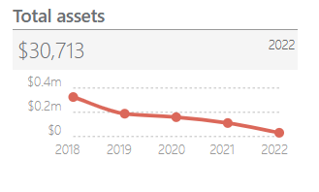
How has funding changed over time?
Pandemic woes
Much like other charitable organizations, FoCSS responded to the pandemic by pulling back on fundraising from community members as many of us adjusted to changing needs at home.
This has resulted in a shortfall of revenue and our expenses are quickly outpacing our income.
We are currently looking at a shortfall of about $60,000 to continue to fund activities at our current level.

Slide 14
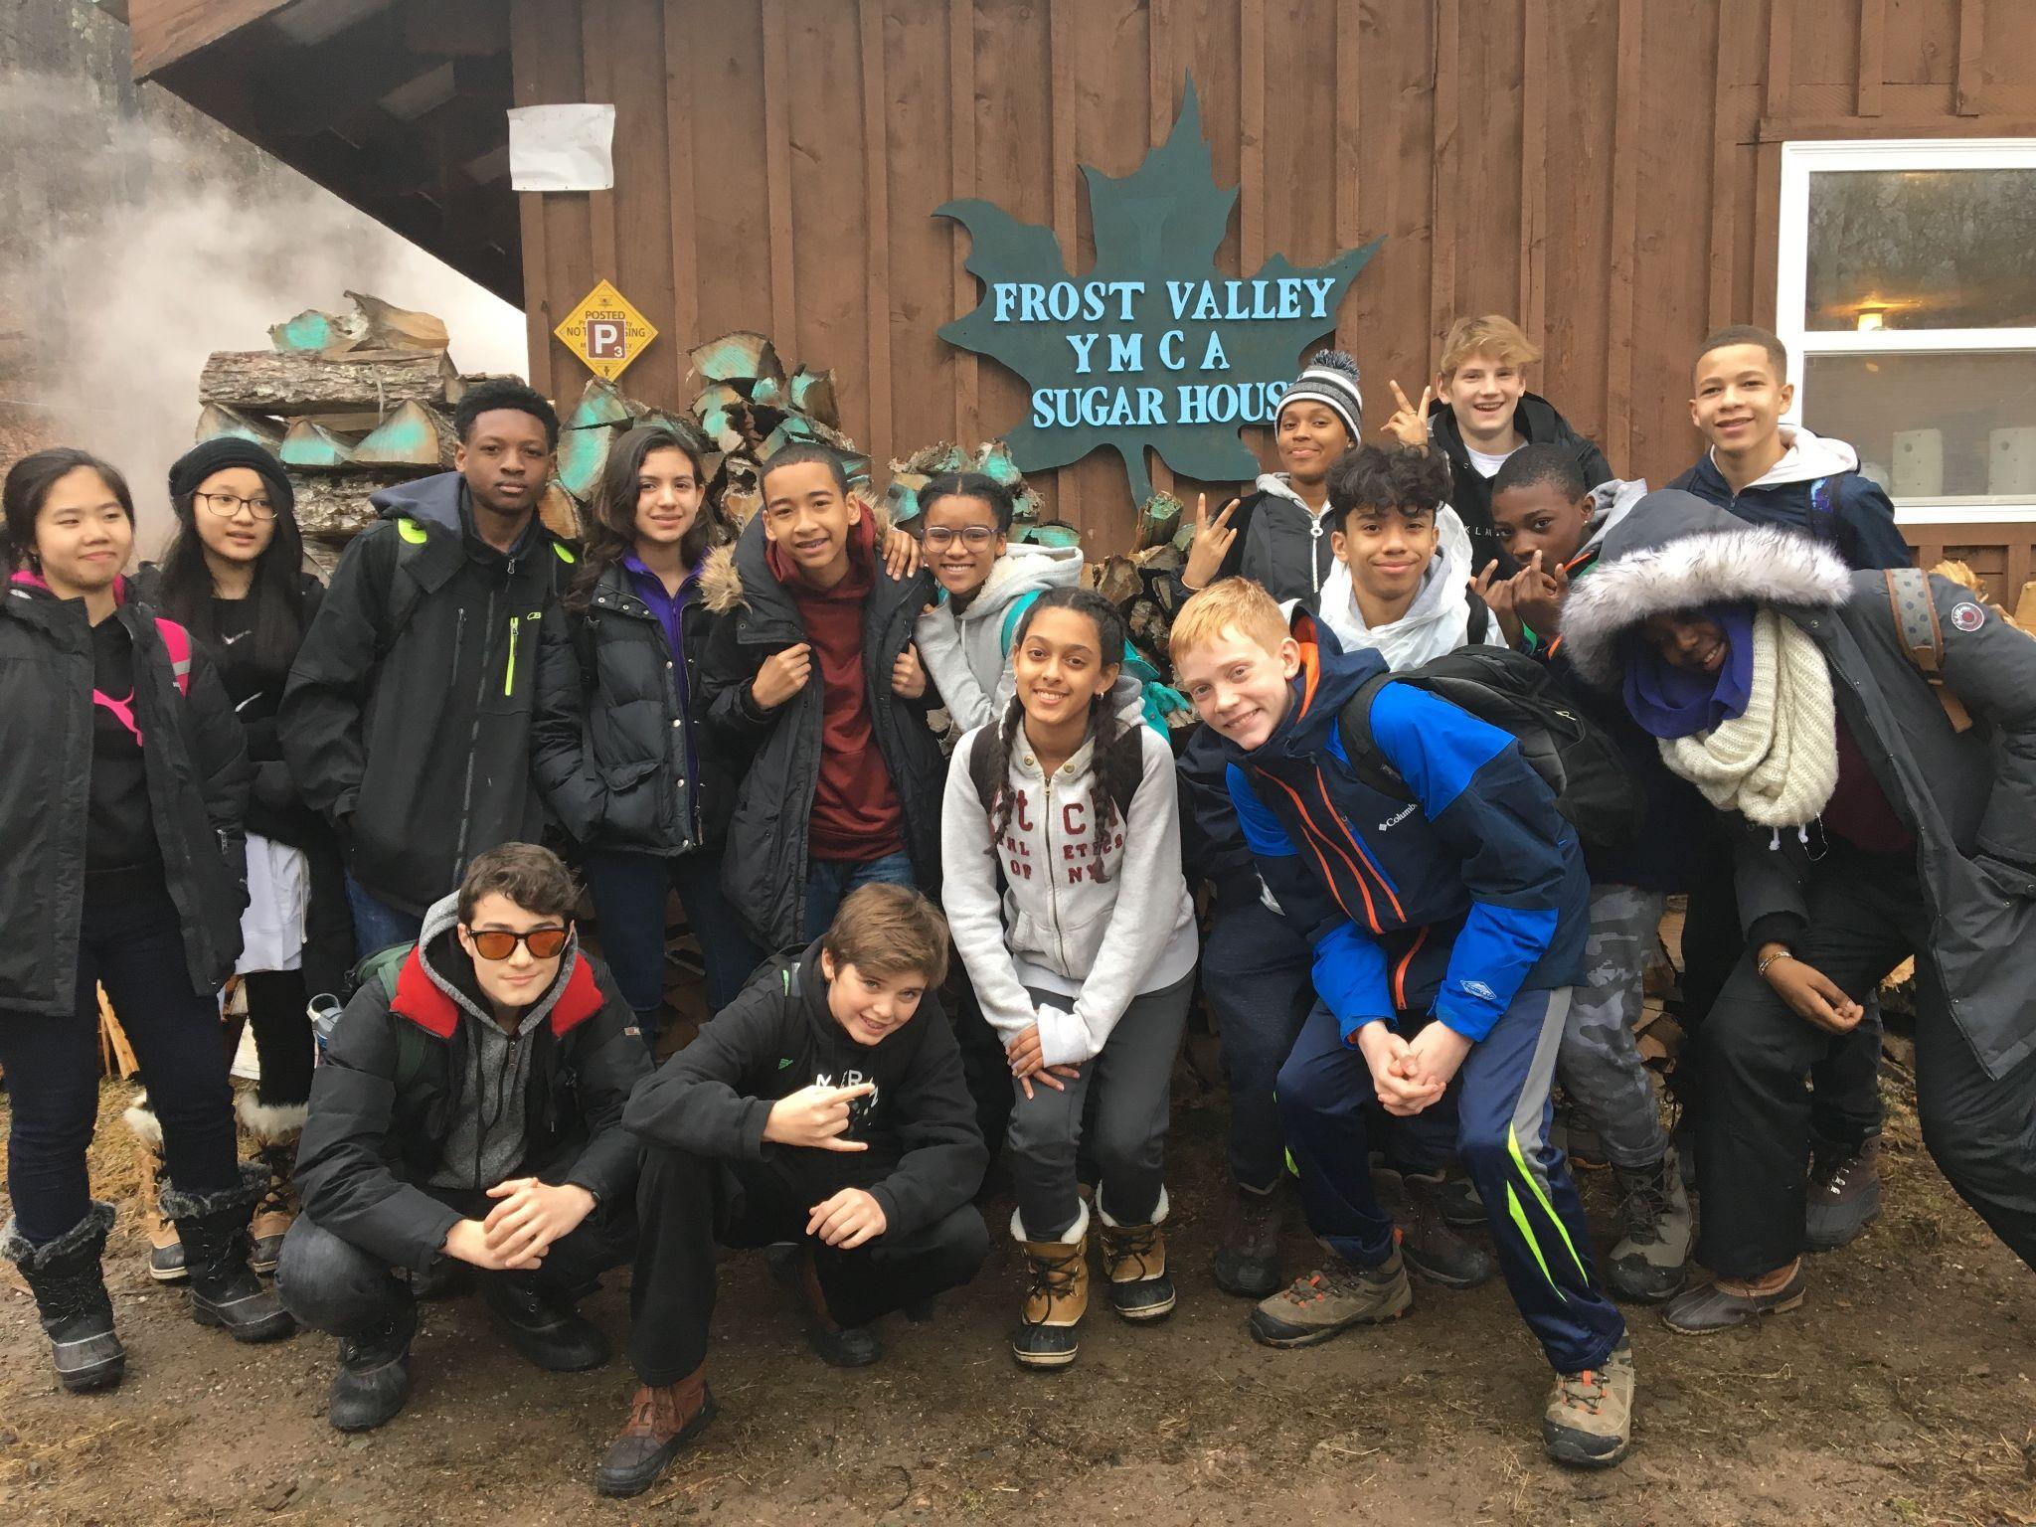
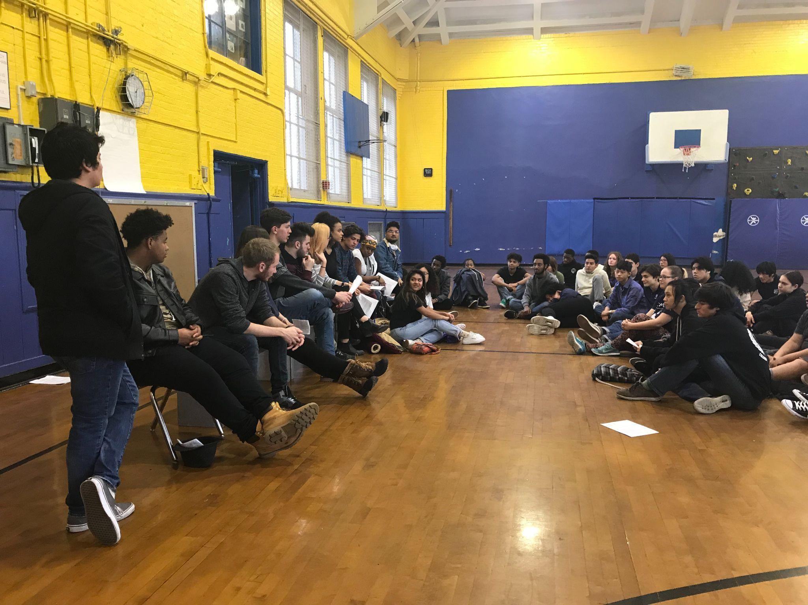
How does FoCSS spend its funds?

Slide 15
How are funds spent?
Historically, FoCSS has supported and subsidized almost all of the extra curricular activities at CSS, including field trips and college trips, clubs and electives and special evengts such as the musical. We have also helped defray costs of AP exams, funded Naviance and picked uo the cost of college texts for students taking courses at CU.
Our largest expense category is salaries. FoCSS pays entire salaries for
Two college counselors and occasional college office support.
A variable number of school aides – the number of fully funded school aides depends on the needs of the school and is decided in consultation with the Principal
Our technology team!
We also pay per session to support after school activities and provide funding for extra teacher costs associated with after school and overnight trips.
CSS would not have these amazing resources without the funding from FoCSS. These are essential supports for our students, staff and parent community!

Slide 16
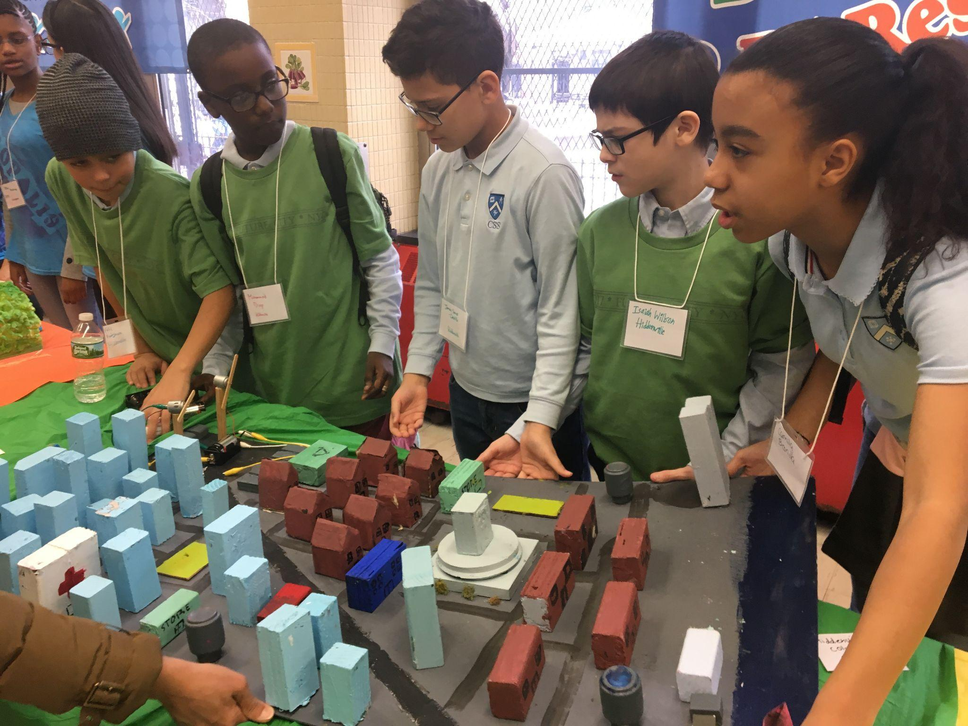
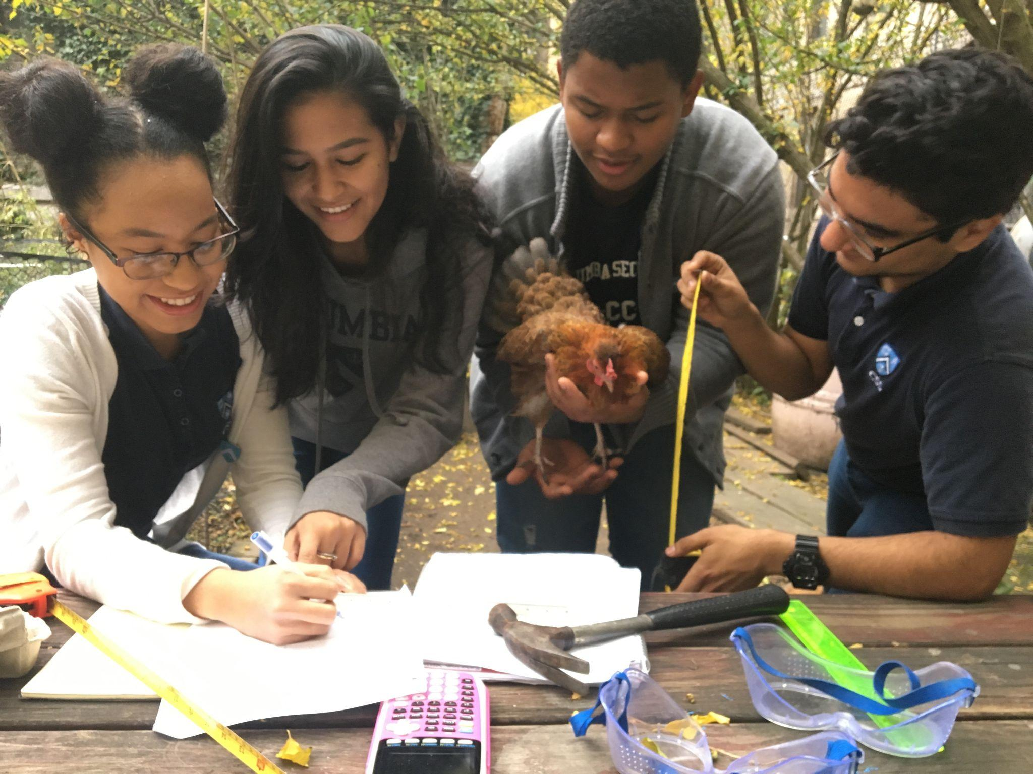
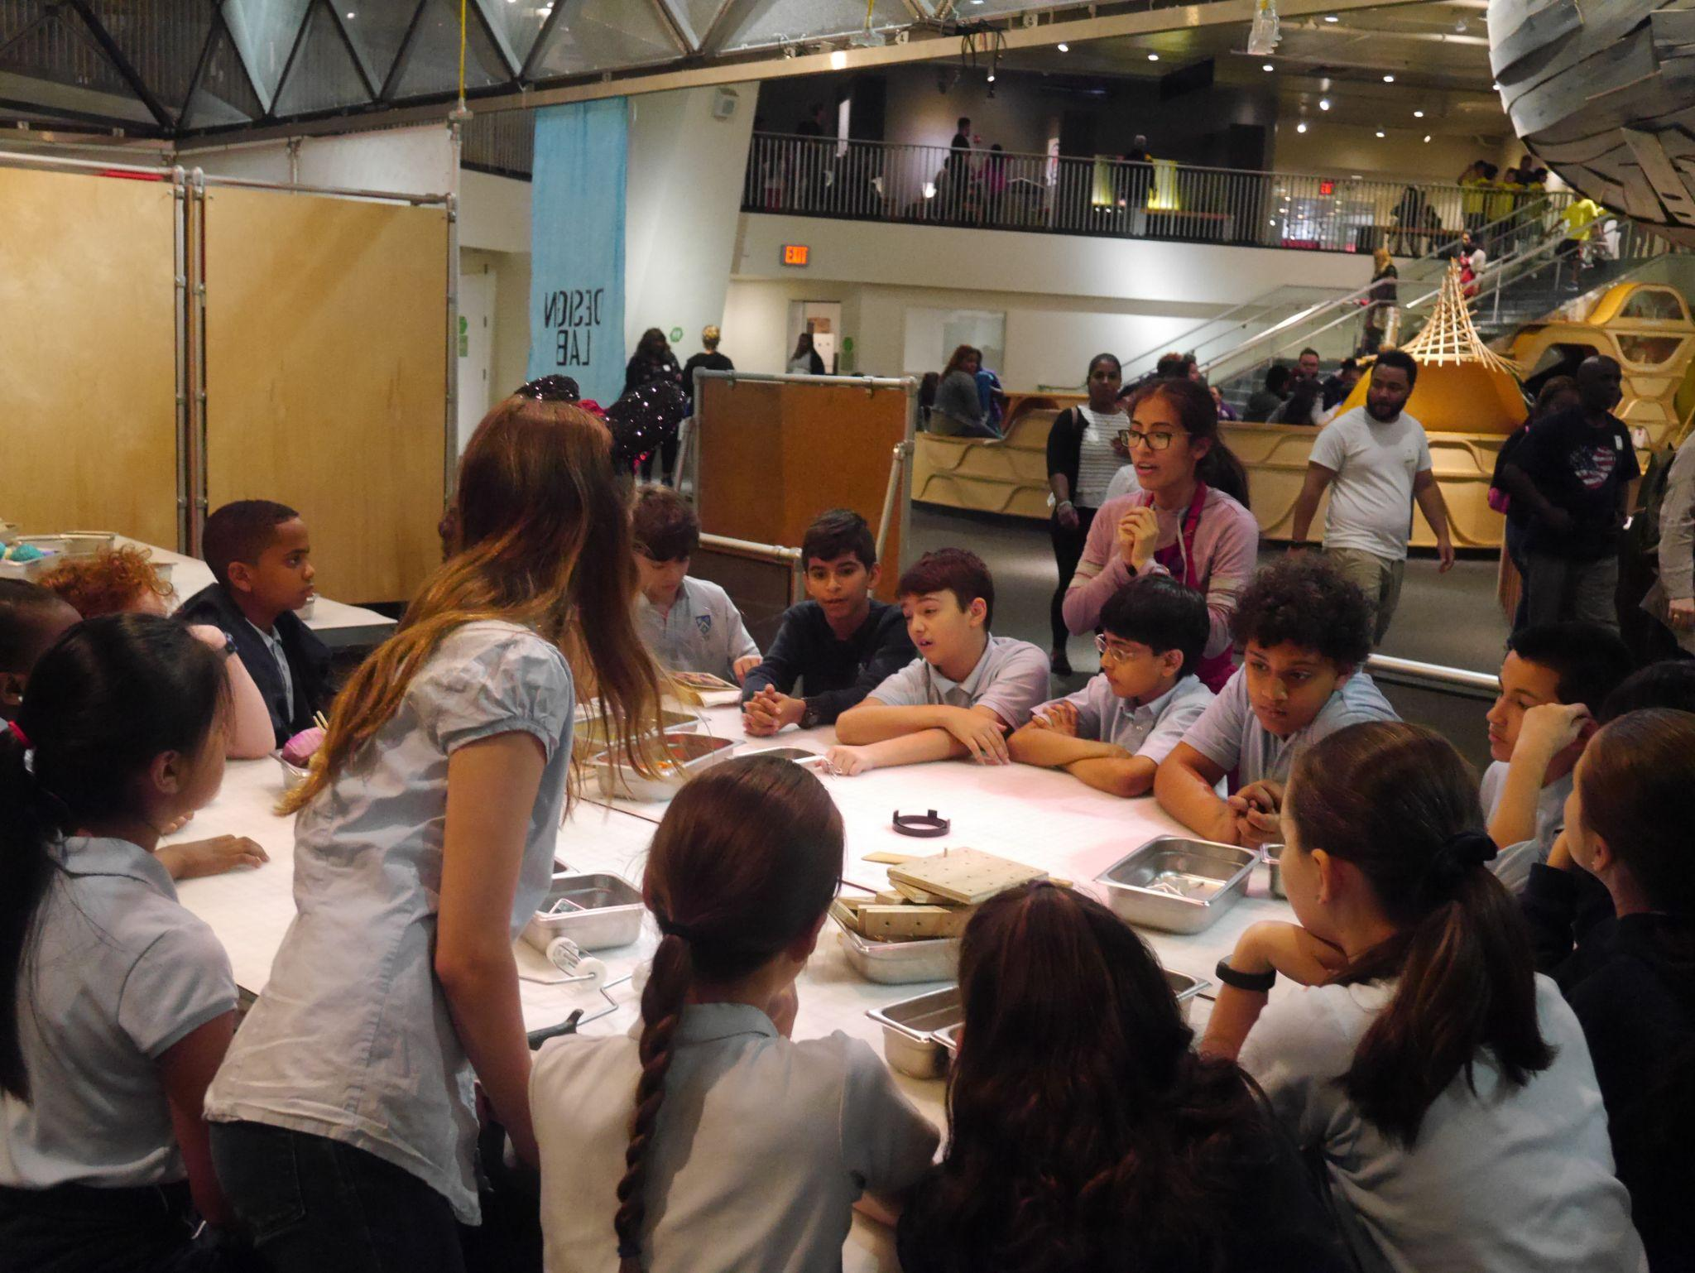
How are funds spent?
Electives | Field Trips
Academic Support, Future City, First Robotics, Debate, GSA, BSU, Student Government, Musical, Contrariwise, CSS Pride Newspaper, Talent Shows, Model UN, Dance, Art, and so much more! | Frost Valley, June trips, College trips, class trips, senior trips

Slide 17
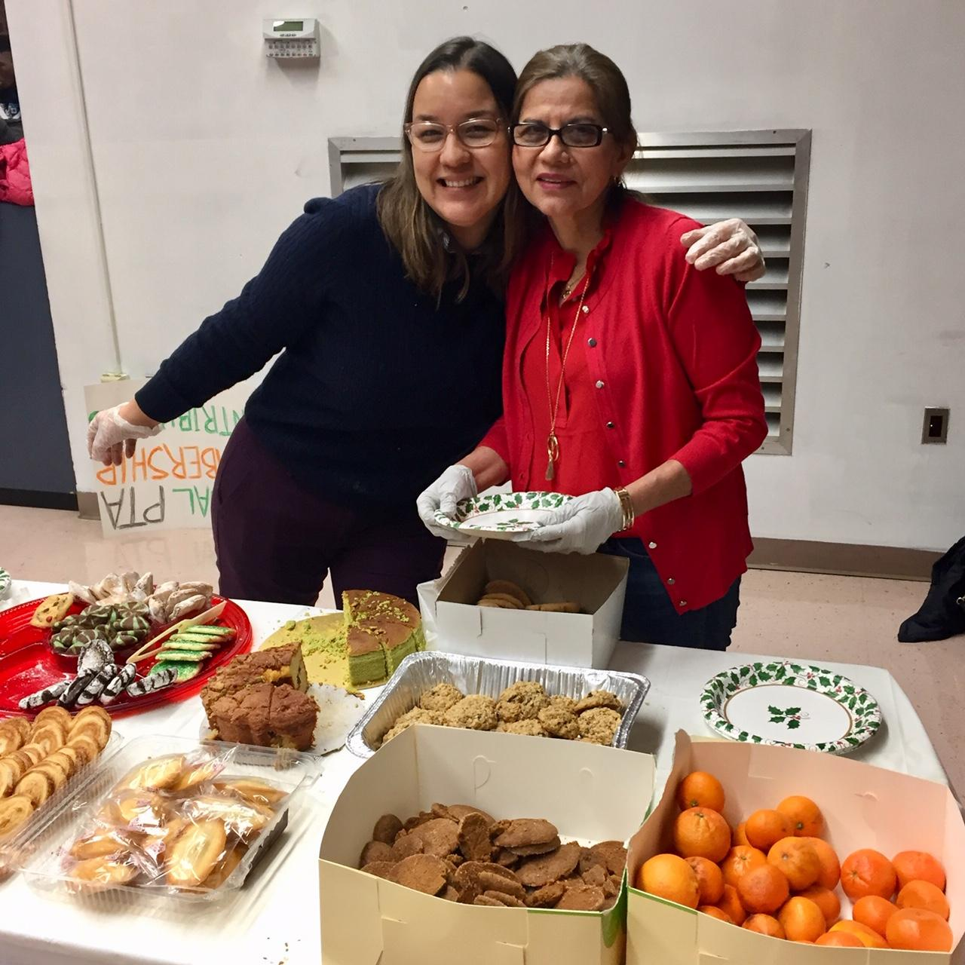
FoCSS and PTA work together
How is FoCSS different from the PTA in what it funds?
In general, FoCSS pays people and the PTA provides material goods, but we work together to support activities. While FoCSS might fund the coach salaries for a sports team, the PTA might purchase their uniforms. FoCSS might support the musical by funding electives and rehearsals while the PTA might provide funds for props and microphones. Each organization plays an important part in supporting activities at CSS.

Slide 18
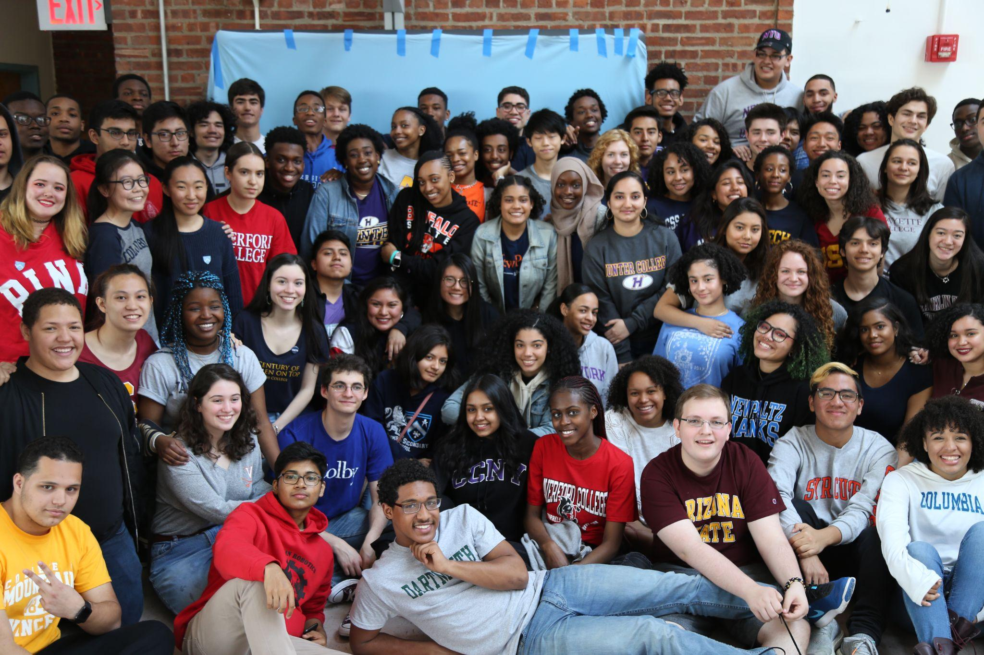
How can you help?

Slide 19
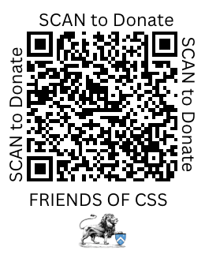
How can you help?
FoCSS is looking at a shortfall of about $60,000 to provide our current level of services at CSS. Please help us continue to provide activities and staff for our students!
Donate through our PayPal site at Donate (paypal.com)
Check with employers to see if they have matching fund or grant programs
Check with your network to see if there are possible donors, grants or foundations that may be interested in supporting CSS!
If you are interested in serving on the Board of FoCSS, contact Min Hong at President_FriendsofCSS@columbiasecondary.org

Slide 20
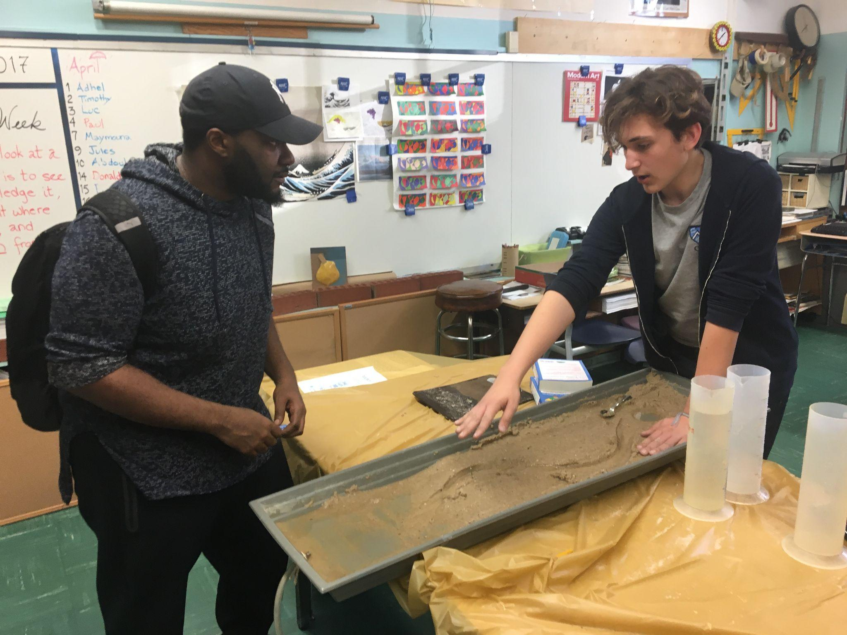
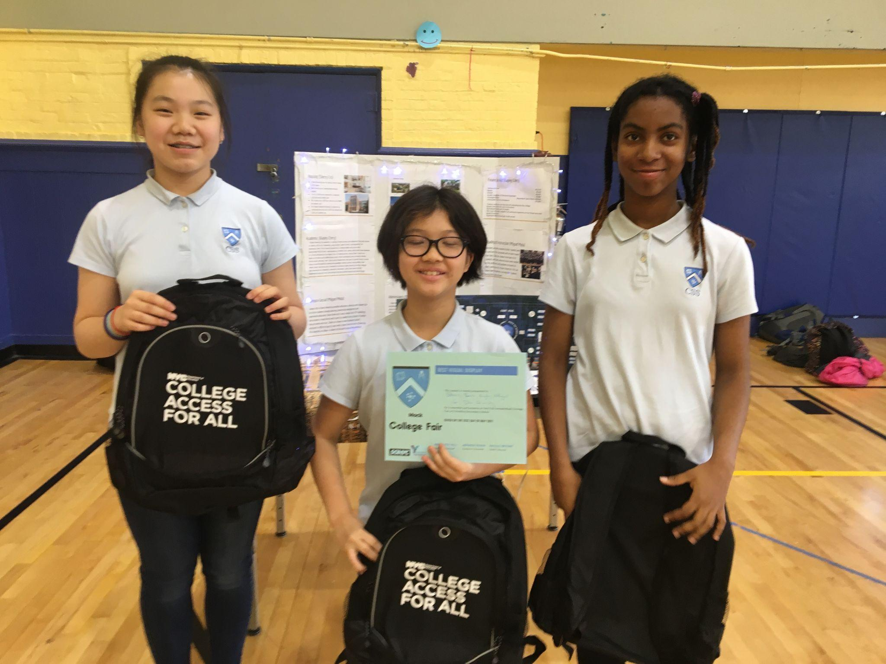
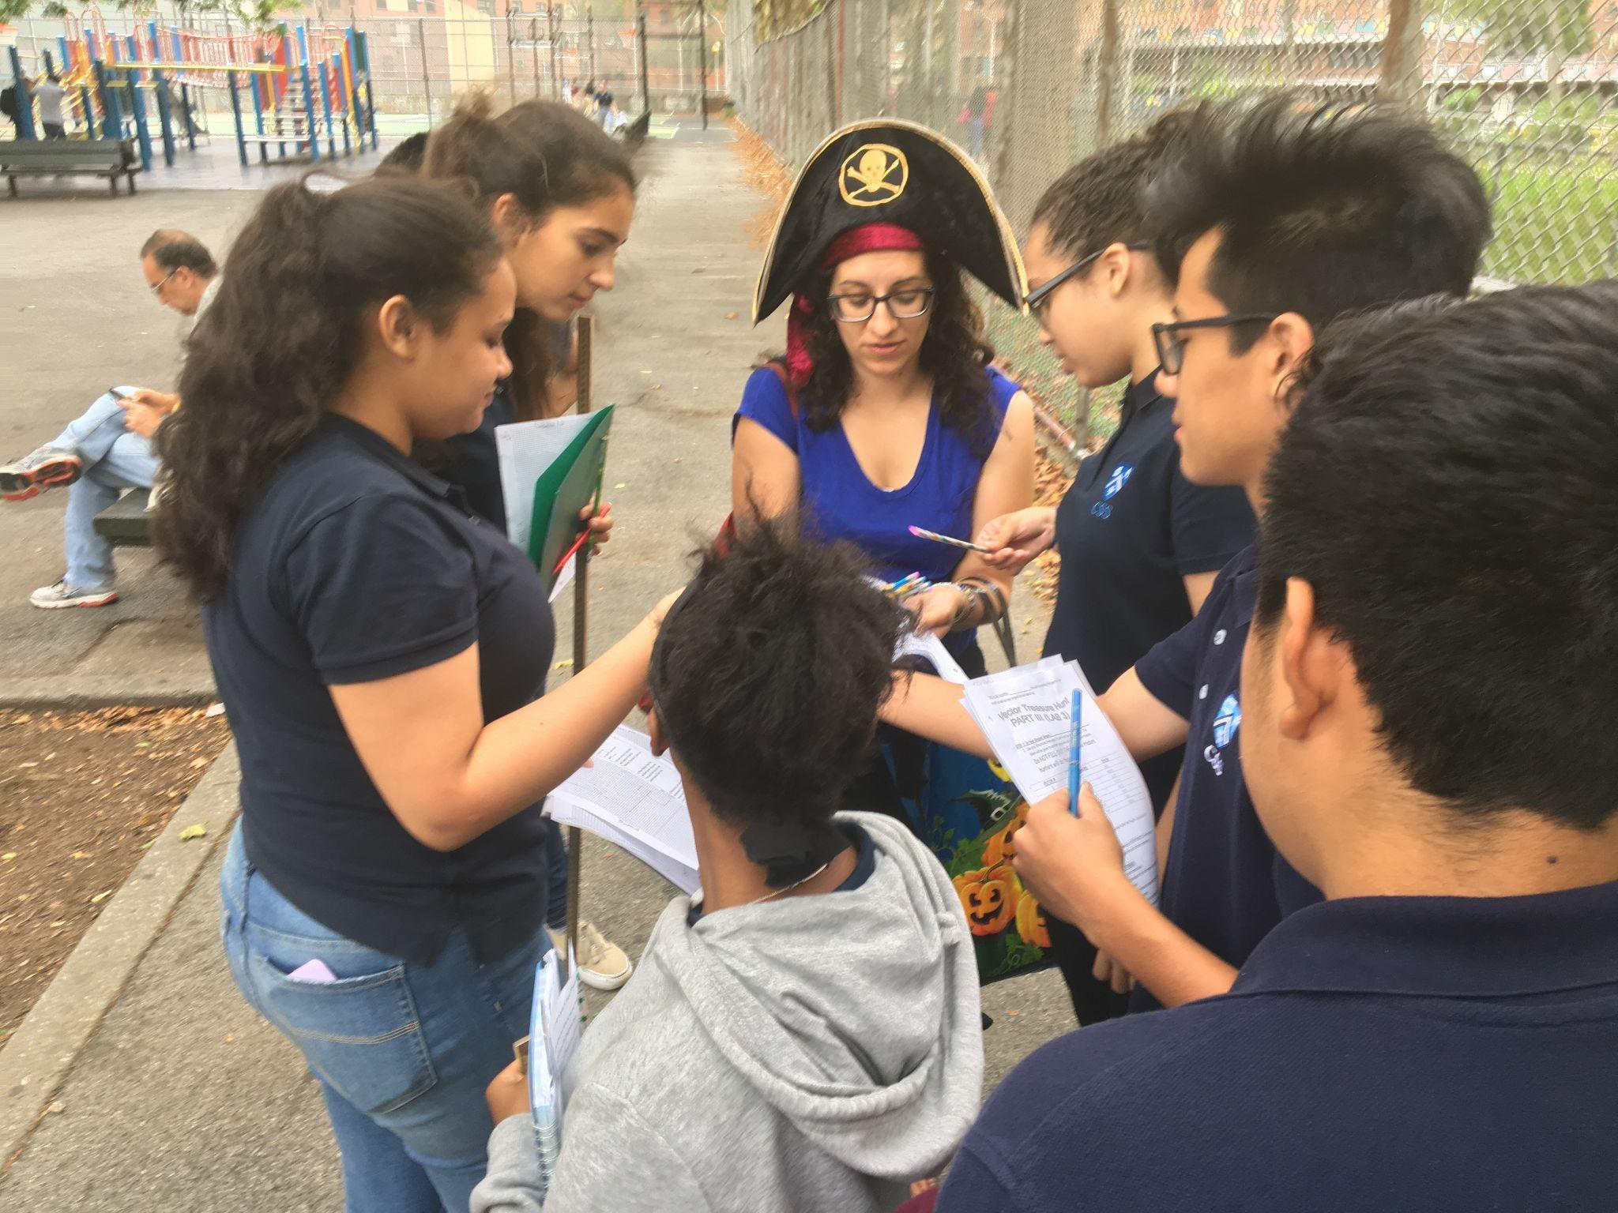
Questions?

